Slide 1
Software Maintenance
Mehwish Mumtaz

Slide 2
Evolution
“Evolution is staged process of progressive change over time in the properties, attributes, characteristics, behaviour of some material or abstract, natural or artificial, entity or system” Darwin. Lehman.

Slide 3
The Changing System
Maintenance: any work done to change the system after it is in operation
Software does not degrade or require periodic maintenance
However, software is continually evolving
Maintenance process can be difficult

Slide 4
Evolution vs Maintenance
Does the software evolve
What do we do to allow the evolution?

Slide 5
The Changing System The System Life Span
Will we need maintenance phase?
Even if best practices are followed, still need maintenance
How much change can we expect?
System evolution vs. system decline: better to discard and build a new?
Cost/reliability/adaptability to change unacceptable?

Slide 6
The Changing System Development Time Vs. Maintenance Time
Parikh and Zvegintzov (1983)
Development time: 2 years
Maintenance time: 5 to 6 years
Fjedstad and Hamlen (1979)
39% of effort in development
61% of effort in maintenance
80-20 rule
20% of effort in development
80% of effort in maintenance

Slide 7
The Nature of Maintenance Types of Maintenance
Corrective: maintaining control over day-to-day functions
Adaptive: maintaining control over system modifications: Change in hardware and software environement: example debugger option in compiler
Perfective: perfecting existing functions
Preventive: preventing system performance from degrading to unacceptable levels:error handling

Slide 8
The Nature of Maintenance Who Performs Maintenance
Separate maintenance team
May be more objective
May find it easier to distinguish how a system should work from how it does work
Part of development team
Will build the system in a way that makes maintenance easier
May feel over confident, and ignore the documentation to help maintenance effort

Slide 9
The Nature of Maintenance Maintenance Team Responsibilities
Locating and correcting faults
Answering questions about the way the system works
Restructuring design and code components
Rewriting design and code components
Deleting design and code components that are no longer useful
Managing changes to the system as they are made
Understanding the system
Locating information in system documentation
Keeping system documentation up-to-date
Extending existing functions to accommodate new or changing requirements
Adding new functions to the system
Finding the source of system failures or problems

Slide 10
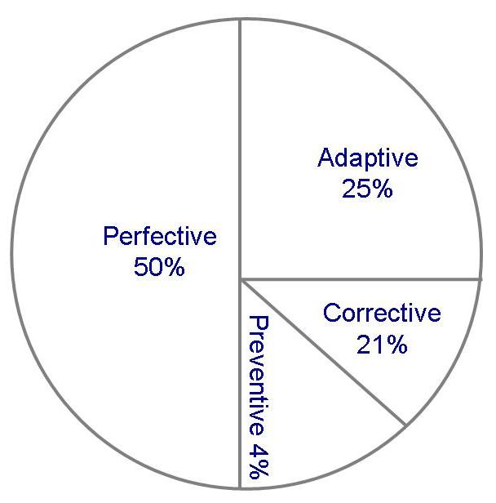
The Nature of Maintenance Use of Maintenance Time
Graphical representation of distribution of maintenance effort (Lientz and Swanson)

Slide 11
Maintenance Problems
Staff problems
Limited understanding (47% of effort is spent on understanding)
Management priorities: rushing a new product to the market
Technical problems
Testing difficulties (some systems must be available around a clock)
E.g reservation system

Slide 12
Maintenance Problems The Need of Compromise
Balancing need for change with the need for keeping the system available to users
Principles of SE compete with expediency (convenience)and cost
Fixing problem quick but inelegant solution, or more involved but elegant way
Solving problem involves only the immediate correction of a fault

Slide 13
11.3 Maintenance Problems Factors Affecting Maintenance Approach
Effort depend on the following:
The type of failures
The failure’s critically or severity
The difficulty of the needed changes
The scope of the needed changes
The complexity of the components being changed
The number of physical locations at which the changes must be made

Slide 14
Maintenance Problems
Benefits
Maintenance changes to a single object class may not affect the rest of the program
Maintainers can reuse objects easily
Drawbacks
OO techniques may make programs more difficult to understand
Multiple parts can make it difficult to understand overall system behavior
Inheritance can make dependencies difficult to trace
By hiding the details of data structure, program function is often distributed across several classes

Slide 15
Maintenance Problems Factors Affecting Maintenance Effort
Application type
Turnover and maintenance staff ability
System life span
Hardware characteristics
Design quality
Code quality
Documentation quality
Testing quality

Slide 16
11.3 Maintenance Problems Modeling Maintenance Effort: Belady and Lehman
M = p + K^{c-d}
M : total maintenance effort
p : productive effort
c: complexity
d : degree of familiarity
K : empirical constant

Slide 17
11.3 Maintenance Problems Modeling Maintenance Effort: COCOMO II(Constructive Cost Model)
Size = ASLOC (AA + SU + 0.4DM + 0.3CM + 0.3IM)/100
ASLOC: number of source lines of code to be adapted
AA: assessment and assimilation effort
SU: amount of software understanding required
DM: percentage of design to be modified
CM: percentage of code to be modified
IM: percentage of external code to be integrated

Slide 18
11.3 Maintenance Problems COCOMO II Rating for SU
 | Very low | Low | Nominal | High | Very high
Structure | Very low cohesion, high coupling, spaghetti code | Moderately low cohesion, high coupling | Reasonably well structured, some weak area | High cohesion, low coupling | Strong modularity, information hiding in data and control structure
Application clarity | No match between program and application worldviews | Some correlation between program and application | Moderate correlation between program and application | Good correlation between program and application | Clear match between program and application worldviews
Self descriptiveness | Obscure code; documentation missing, obscure, or obsolete | Some code commentary headers; some useful documentation | Moderate level of code commentary headers, and documentation | Good code commentary and headers; useful documentation; some weak areas | Self descriptive code; documentation up-to-date , well organized, with design rationale
SU increment | 50 | 40 | 30 | 20 | 10

Slide 19
Example
Suppose that we need to perform a maintenance task. We estimate that the task needs 10,000 Lines of Code to be adapted. Let us assume that the value for design modification is 10%, the value for code modification is 20%, and the value for code integration is 40%. Suppose that AA was 4%, SU was 30%. What would be the COCOMO II based estimate of size for the maintenance task?
Sol.
Let Adaptation Adjustment Factor (AAF) = (.4DM +.3CM +.3IM)
Size = ASLOC (AA + SU + AAF)/100
AAF = ( 0.4 x 0.1 ) + ( 0.3 x 0.2 ) + ( 0.3 x 0.4 ) = 0.22
Size = 10000(0.04 + 0.3 + 0.22)/100 = 56

Slide 20
11.4 Measuring Maintenance Characteristics
Maintainability is not only restricted to code, but also including specification, design and test plan documentations
Maintainability can be viewed in two ways
External view of the software:person performing maintenance
Internal view of the software: measuring before delivery
Cyclomatic complexity

Slide 21
11.5 Maintenance Techniques and Tools
Configuration management
Configuration control board
Change control
Impact analysis
Automated maintenance tools

Slide 22
11.5 Maintenance Techniques and Tools Configuration Control Process
Problem discovered by or change requested by user/customer/developer, and recorded
Change reported to the configuration control board
CCB discusses problem: determines nature of change, who should pay
CCB discusses source of problem, scope of change, time to fix; they assign severity/priority and analyst to fix
Analyst makes change on test copy
Analyst works with librarian to control installation of change
Analyst files change report

